Slide 1

WiFi Analytics Platform
A Data-Driven System to Analyze Customer Behavior, Movement, Engagement, and Network Quality
ZIAD ADEL

Slide 2

Project Overview & Goal
Data Sources Connected
We integrate Device Details, Session Timestamps, Movement Zones, Visit Frequencies, and Network Metrics to build a complete profile.
Primary Goal
Analyze visitor behavior and network performance to improve operational efficiency and customer experience inside the venue.

Slide 3









Data Architecture & Methodology
Core Tables
Methodology
Output
Visitor_Info, Visit_Info, Session_Info, Location_Info. Joined via device_id & session_id.
SQL Server 2012 for heavy calculation and Python (Matplotlib/Seaborn) for advanced visualization.
Key Metrics answering critical business questions like Dwell Time, Peak Hours, and Disconnects.

Slide 4
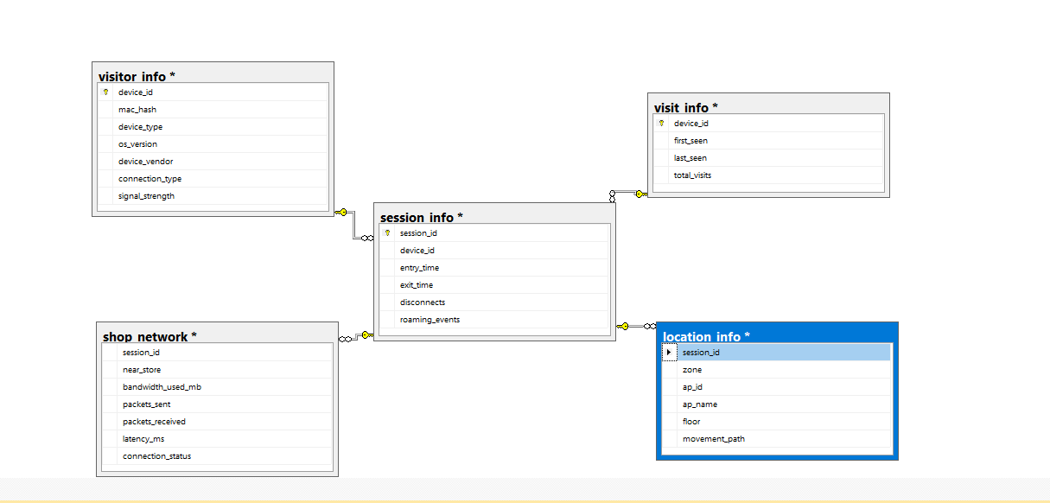
WiFi Analytics Database ERD
Data Architecture & Methodology
Core Tables
Methodology
Output
Visitor_Info, Visit_Info, Session_Info, Location_Info. Joined via device_id & session_id.
SQL Server 2012 for heavy calculation and Python (Matplotlib/Seaborn) for advanced visualization.
Key Metrics answering critical business questions like Dwell Time, Peak Hours, and Disconnects.

Slide 5









Key Insights: Visitor Behavior
Avg. Visitor Time
Repeat Visitors
Peak Hours
~92 Min
94.9%
11, 5, 10
High engagement; the venue retains visitors effectively.
Exceptional Loyalty—a very strong base of returning customers.
Critical pressure points for staffing, services, and network load.

Slide 6
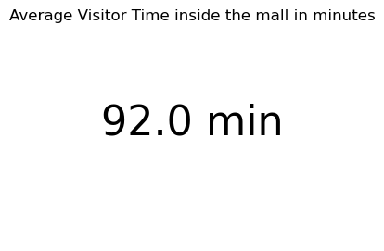
Key Insights: Visitor Behavior
Avg. Visitor Time
Repeat Visitors
Peak Hours
~92 Min
11, 5, 10
High engagement; the venue retains visitors effectively.

Slide 7
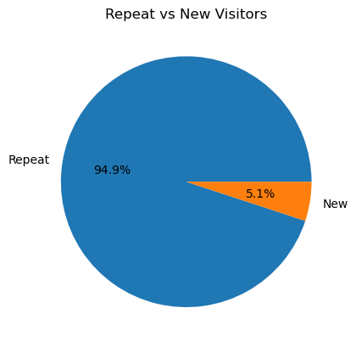
Key Insights: Visitor Behavior
Repeat Visitors
94.9%
Exceptional Loyalty—a very strong base of returning customers.

Slide 8
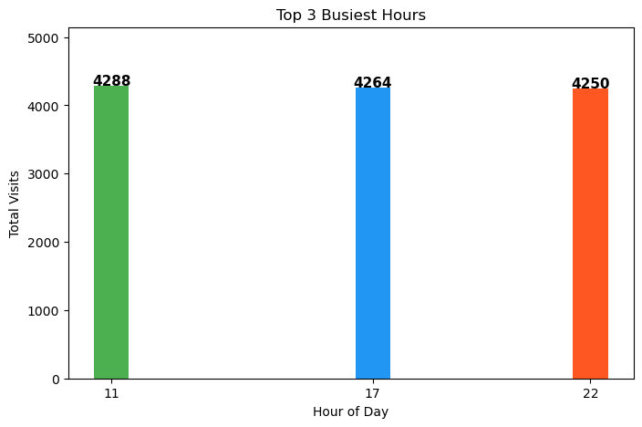
Key Insights: Visitor Behavior
Peak Hours
11am, 5pm, 10pm
Critical pressure points for staffing, services, and network load.

Slide 9


Zone Traffic & Visitor Time
Busiest Zones
Highest Time spent
•
Clothes
•
Clothes
•
Checkout
•
Checkout
•
Main Hall
•
Café Area
Suggests high purchasing activity and confirms the Main Hall as a central transit hub.
Time spent is consistent with the purchasing journey (Clothes → Checkout) and natural rest (Café).

Slide 10
Movement Path Analysis
Clothes
Main Hall
Café
Browsing Start
Transit Hub
Rest & Refresh
Checkout
Entrance
High Conversion
Exit/Re-entry
Key Insight: The flow clearly indicates users move from purchase (Clothes → Checkout) to rest (Electronics → Café).

Slide 11
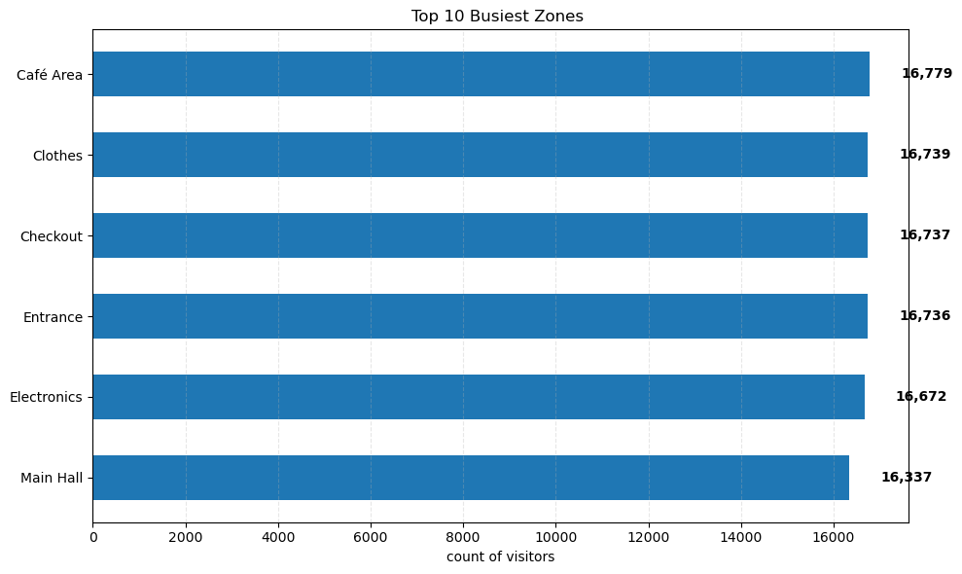
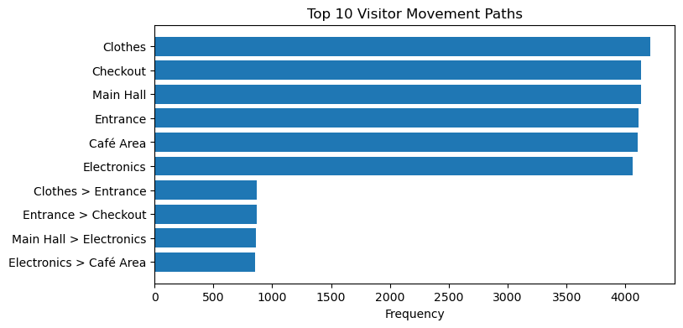
Zone Traffic & Movement Path Analysis
Zone Traffic & Visitor Time
Busiest Zones
Highest Time spent
•
Clothes
•
Clothes
•
Checkout
•
Checkout
•
Main Hall
•
Café Area
Suggests high purchasing activity and confirms the Main Hall as a central transit hub.
Time spent is consistent with the purchasing journey (Clothes → Checkout) and natural rest (Café).

Slide 12
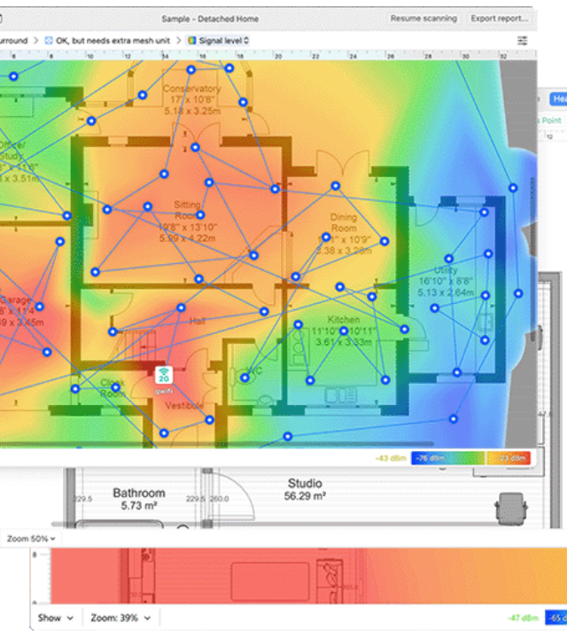
Network Quality & Hotspots
High Disconnect Zones
Main Hall, Electronics, Café Area
Root Cause
The combination of high traffic volume and long dwell time in these specific zones leads to network saturation and performance drops.
Technical Finding
A Normalized Heatmap analysis pinpointed these specific coordinates as needing urgent infrastructure attention.

Slide 13
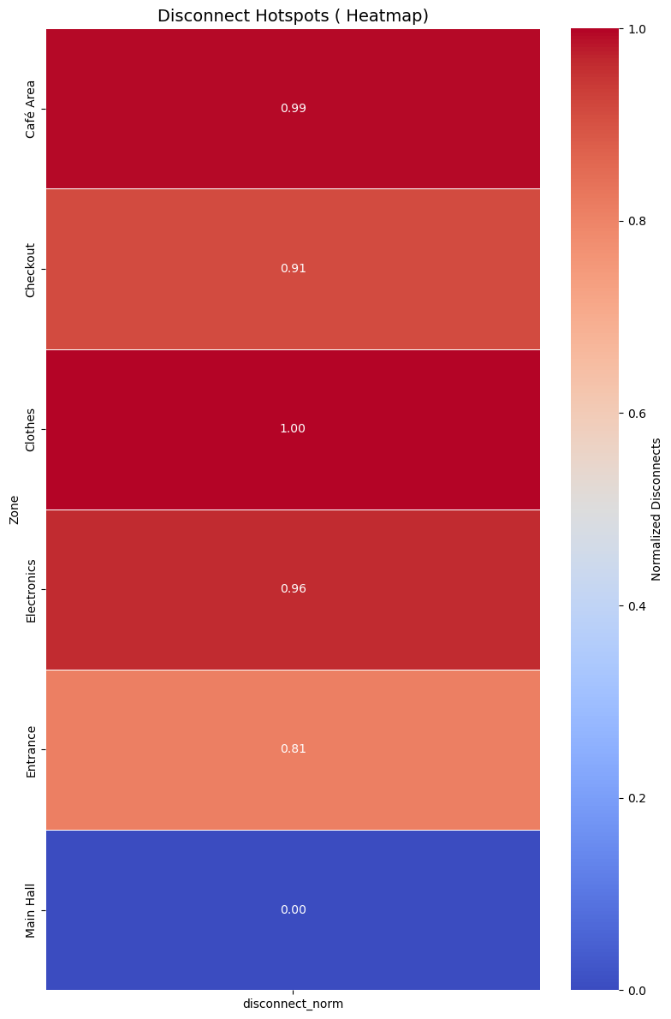
High Disconnect Zones
Zone Traffic & Visitor Time
Busiest Zones
Highest Time spent
•
Clothes
•
Clothes
•
Checkout
•
Checkout
•
Main Hall
•
Café Area
Suggests high purchasing activity and confirms the Main Hall as a central transit hub.
Time spent is consistent with the purchasing journey (Clothes → Checkout) and natural rest (Café).

Slide 14



Machine Learning Opportunities
Movement Prediction
Visitor Segmentation
Network Optimization
Use Markov Chains to probabilistically predict a visitor's next zone based on current location.
Clustering algorithms to group visitors by behavior (e.g., "Focused Shoppers" vs "Casual Browsers").
Predict Access Point (AP) overload using load heatmaps to inform dynamic re-positioning.

Slide 15
Visualizations Used
KPI & Traffic
Network Intelligence
Average Dwell Time & Repeat Visitor Pie Chart
Quick snapshots of engagement.
Zone Traffic Ranking
Identifying the most valuable floor space.
Peak Hour Bar Chart
Visualizing traffic density over time.
Disconnect Hotspot Heatmaps
Spatial analysis of network failures.
Movement Path Sankey
Flow analysis between zones.

Slide 16


Final Outcomes
Business Impact
Technical & UX
Operational Insights: Optimize staffing and scheduling during peak hours (11am, 5pm).
Technical Insights: Proactively enhance WiFi performance and coverage in hotspot zones.
Marketing Insights: Optimize store placements and product adjacency (e.g., Combo Offers).
Behavioral Insights: Improve the overall customer experience by smoothing out identified pain points.

Slide 17
Next Steps
Dashboarding
Deployment
Build interactive Power BI / Tableau views.
Deploy predictive models into production.
Live Integration
Automation
Stream real-time data for operational alerts.
Automate weekly & monthly reporting.

Slide 18

Thank You
Ziad Adel
Open for Questions

